Slide 1
A1: Conceptual Architecture
Presents by: TBA
​Members: Yihao Chen , Yuhao Chen , Coco Chen , Brayden Dewar , Lena Krause , Selin Onsoz
Notes:
Hello everyone and welcome to our Conecptual Architecture presentation.
We are group TBA, my name is brayden and these are my team members Yihao, Steven, Coco, Lena, and Selin

Slide 2
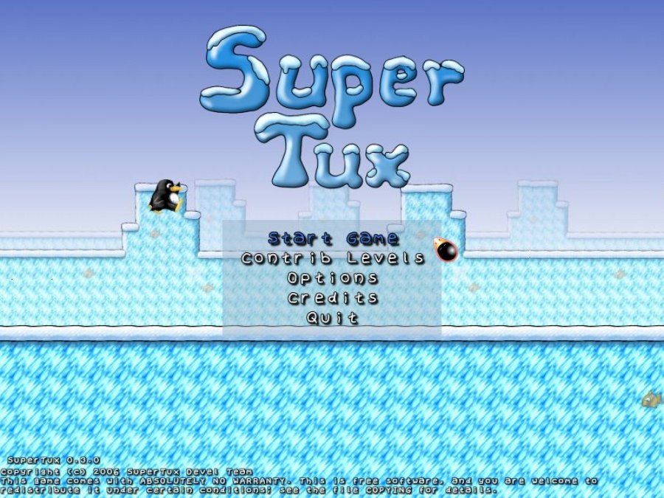
Architecture Study - SuperTux
Open Source
2D Platformer
Similar to original Mario games
Ideal for introductory software architecture study
Notes:
To start off; a little bit about SuperTux
Supertux is an open source 2d platformer game and is very similar to the original mario games.
It has been in development for over a decade and the many resources regarding its development and its code make it ideal for an introductory software architecture study

Slide 3
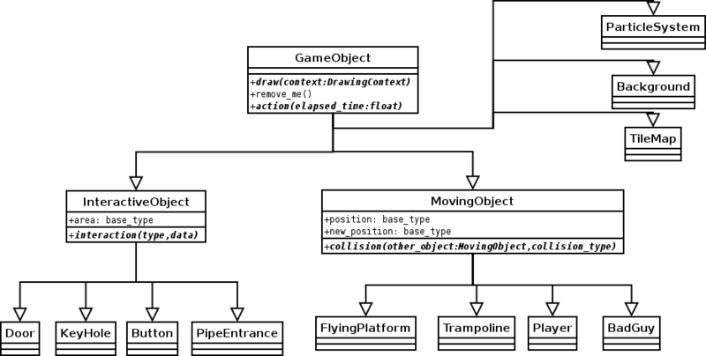
Derivation Process
Object hierarchy from SuperTux wiki
Diagram created by SuperTux developers
Seems to have an object oriented structure
http://supertux.lethargik.org/wiki/Game_object
Notes:
Before we introduce our conceptual architecture I am going to talk a bit about our derivation process
One of the first things we did as a group was do some research on SuperTux and its Development, which led us to the supertux wiki, where we found this object hierarchy.
This object hierarchy was created by a developer of SuperTux. It shows how all of the in game objects such as Tux, enemies, items, and more are encapsulated.in the code.
Seeing this hierarchy early on gave us the idea that the conceptual architecture we end up with should probably be Object Oriented

Slide 4
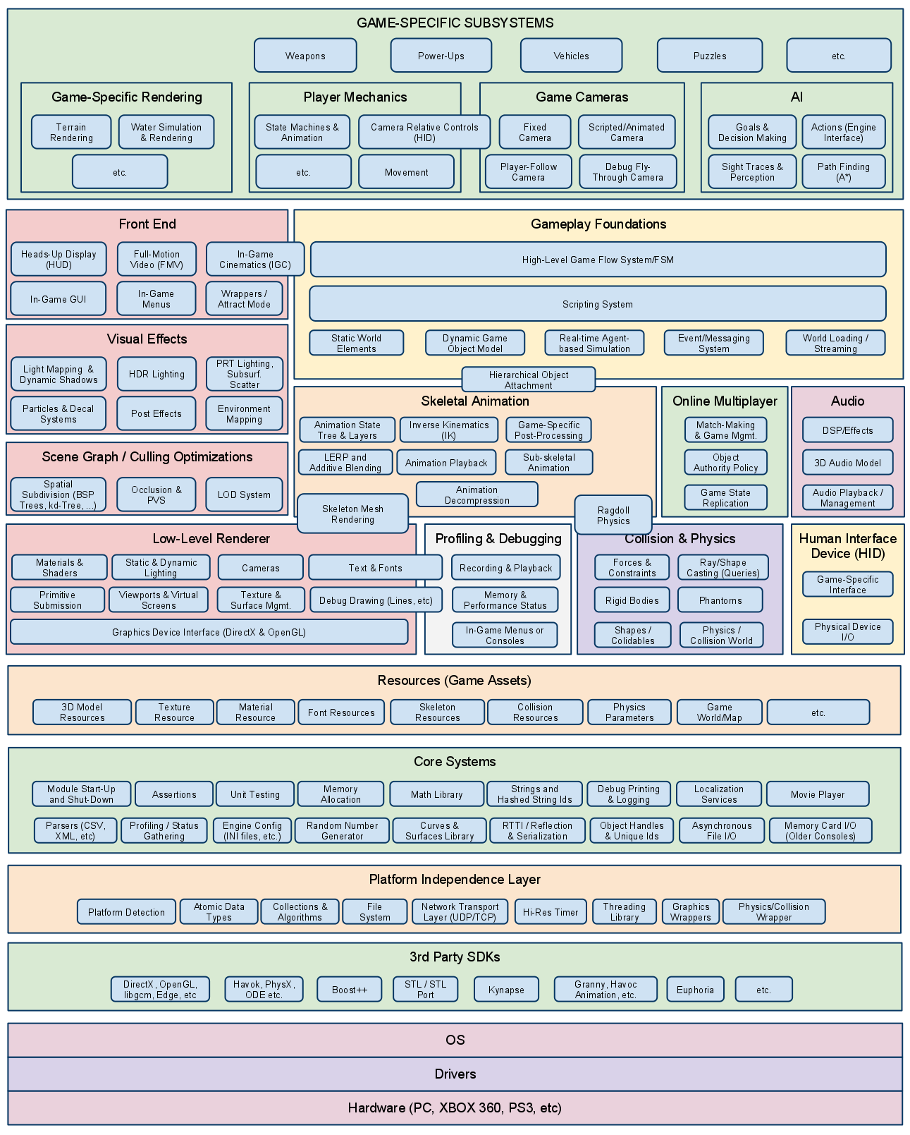
Reference Architecture
The reference architecture used: “Game Engine Architecture”
Layered architecture
Team’s process for coming up with the conceptual architecture involved:
playing SuperTux, and
using the reference architecture to identify the unique subsystems
Conclusion: Mix of layered and object-oriented
Notes:
We then took to the Game Engine Architecture document to find our reference architecture. This is a general game architecture that can be used for many genres.
We learned 2 important things from this reference architecture: 1: game architectures are usually layered and 2. The variety of subsystems that are found within the conceptual architecures of games
Our next step in the process was to play supertux for ourselves and determine which subsystems in the reference architecture play a major role in SuperTux. After this point in the process we had aquired our Subsystems, Our reference architecture, and object hierarchy, so we finally were able to construct our conceptual architecture
What we came up with was a conceptual architecture with an object oriented and layered style

Slide 5
USER INTERFACE
I/O
GAME SPECIFIC SUBSYSTEMS
Level Management
Game Objects
Level Editor
World Map
Addon Manager
RESOURCES
Physics
Audio
Graphics
Legend
subsystem
dependency
Hardware Abstraction Layer

Slide 6
User Interface
USER INTERFACE
I/O
Means by which the user and SuperTux game system interact.
Manages menus throughout the game.
Retrieves input from user devices.
Outputs all graphical and audio
GAME SPECIFIC SUBSYSTEMS
Level Management
Game Objects
Level Editor
World Map
Addon Manager
RESOURCES
Physics
Audio
Graphics
Hardware Abstraction Layer

Slide 7
Game Specific Subsystems
USER INTERFACE
I/O
Game Objects -- Every object in the game is a “GameObject”
Level Management -- Manages the Game Objects to create a playable level
World Map
Level Editor
Add-on Manager handles interaction with online repository
GAME SPECIFIC SUBSYSTEMS
Level Management
Game Objects
Level Editor
World Map
Addon Manager
RESOURCES
Physics
Audio
Graphics
Hardware Abstraction Layer

Slide 8
Resources
USER INTERFACE
I/O
Physics -- Collision detection and response
Audio -- Background music, sounds effect.
Graphics -- Sprites and Animations
GAME SPECIFIC SUBSYSTEMS
Level Management
Game Objects
Level Editor
World Map
Addon Manager
RESOURCES
Physics
Audio
Graphics
Hardware Abstraction Layer
Notes:
LENA
“Resources includes lower level systems the game specific subsystems require in order for the game to actually operate.”
“Physics engine - for collision detection, any game aspects emulating the laws of physics.”
“Graphics engine - renders graphics (graphical data provided by game-specific subsystems) onto computer screen.”
“This is what the game is suppose to look like at this time.”
“Audio engine - produces audio output provided by game-specific subsystems.”
“This is what the game is supposed to sound like at this time.”

Slide 9
Hardware Abstraction
USER INTERFACE
I/O
SuperTux can run on Windows, Mac, Linux and Android
GAME SPECIFIC SUBSYSTEMS
Game Objects
Level Management
Level Editor
World Map
Addon Manager
RESOURCES
Physics
Audio
Graphics
Hardware Abstraction Layer
Notes:
LENA
“All output data from the resources system sent here”
“Because SuperTux can run on multiple platforms, we need a system that can account for different OS and hardware config so the rest of the game does not have to worry about communicating directly with such diverse systems.”

Slide 10
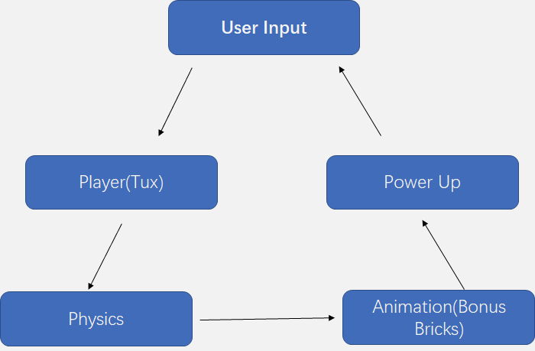
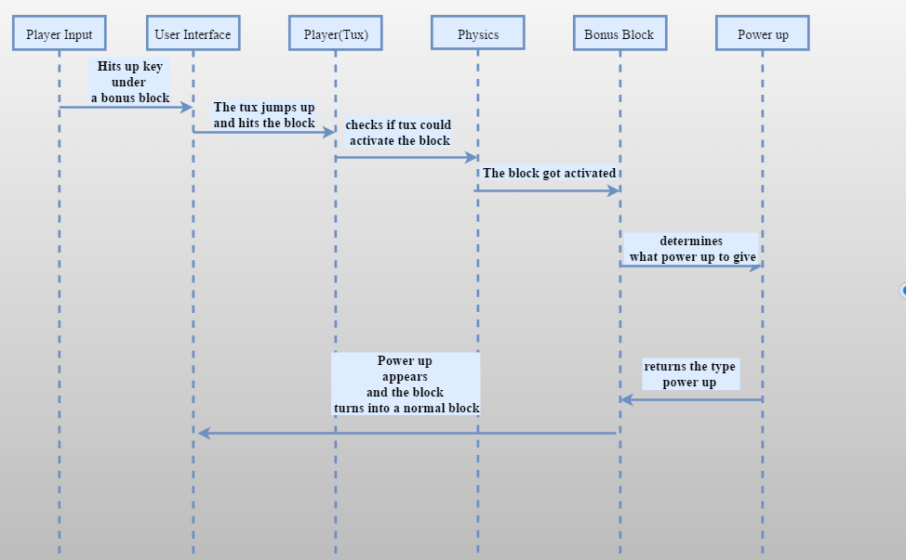
Sequence Diagram
Legend
subsystem
dependency

Slide 11
Advantages/Disadvantages
Layered architectures facilitate user interfaces
Our architecture has high cohesion and low coupling
Objects can be encapsulated efficiently
Ability to divide work of different subsystems within team
Information and output from Audio and Graphics engines travel all the way back up the architecture to UI
Notes:
Our architecture is a mix of layered and object oriented architecture, is based on some/these advantages and disadvantages.
One of the advantages, as User interfaces are really important in games, using layered architecture facilitates user input (UI)
Next, The advantage of the architecture having a high cohesion, meaning they have the same focus, which makes the coding easier and more organized. For object oriented hierarchies, there tends to be high coupling, however we tried to minimize coupling as much as we could. (meaning they wouldnt be as dependent on each other)
The other advantages of the architecture include the objects can havng the ability to be encapsulated efficiently. And ---
The structure of the architecture allows the division of work within the team.
One of the disadvantages is that info and output travelling back up to the architecture to UI from audio and graphics is time consuming.

Slide 12
Concurrency
Audio and graphics
Graphics and gameplay
UI and gameplay
Notes:
There are some concurrencies as they are inevitable in the gameplay of SuperTux.
One of the concurrencies is between the audio and the graphics, as the graphics of the game and the sound effects should be played concurrently. (they complement each other)
Graphics and gameplay. The game will be calculating the elements and is displaying the resultant/relevant graphics on the screen.
User input is needed to generate output and update the game state, so no delay is tolerated between UI and the gameplay.

Slide 13
Lessons Learned
Playing the game can be equally as valuable as researching about architectures
Layered architectures are common in video games
Do not spend too much time doing individual research as opposed to team discussions
Notes:
Working on the conceptual architecture of SuperTux, we have learned some lessons.
You learn just as much from playing the game, when compared to doing research.
We have found in our research that layered architectures are common in video games.
Finally, we have found that brainstorming together and talking about ideas are more helpful at times than doing research individually.

Slide 14
Thank You
We will take any questions now

